Slide 1
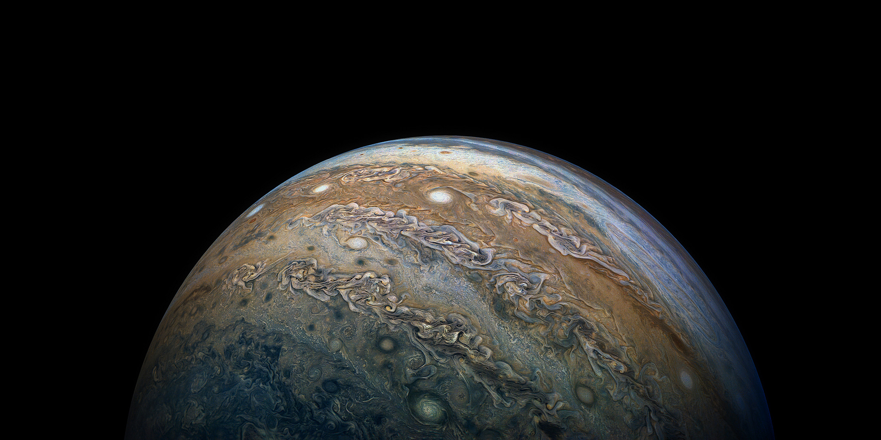
STORMS OF JUPITER
Notes:
Intros
Joseph Spens @josephspens
Rebecca D'Agostino @rd16395p
Russell Brown @cmonkey03
Rachel Cohen @rachelfreya
Mallory Feuer @mfeuer23
Victoria Levchenko @vlevchenko
Problems with the

Slide 2


Slide 3
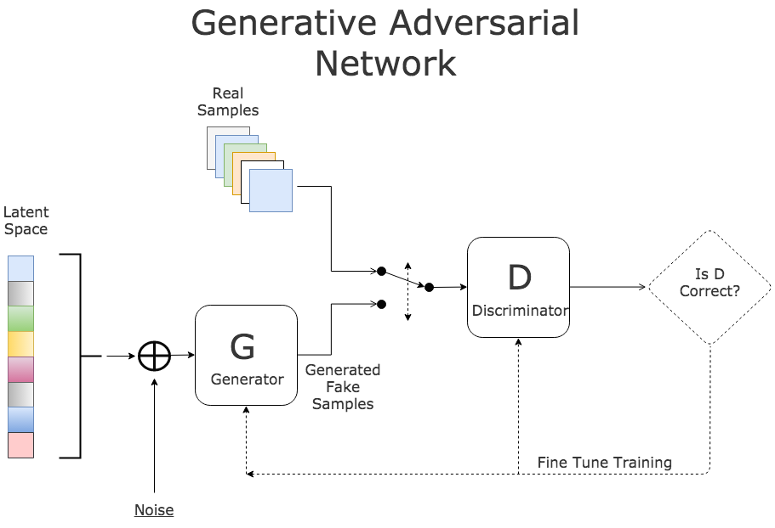

Slide 4


Slide 5
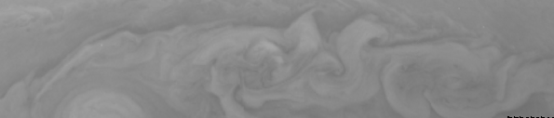
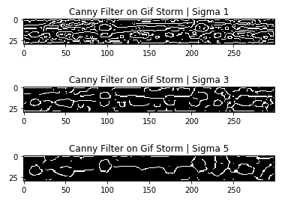
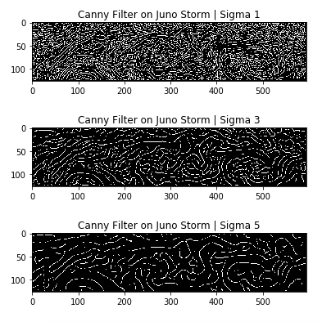

Slide 6
